Slide 1


Slide 2
Database Management Systems
Week 7, Day 2
MongoDB—Aggregate Functions
Atta Muhammad
+92-333-1971110
attapanhyar@quest.edu.pk

Slide 3
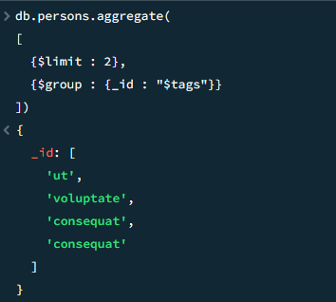
Arrays in $group

Slide 4
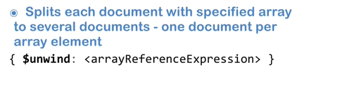
$unwind Stage

Slide 5
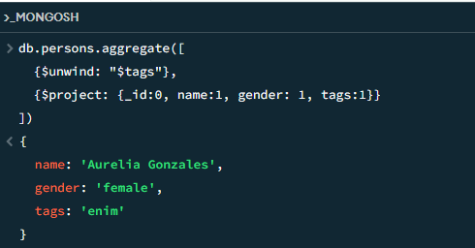
$unwind

Slide 6
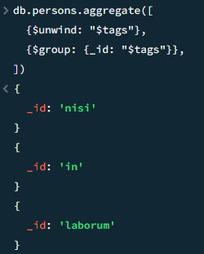
$unwind and $group

Slide 7
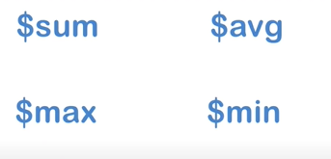
Accumulator Operators

Slide 8

Accumulator syntax

Slide 9
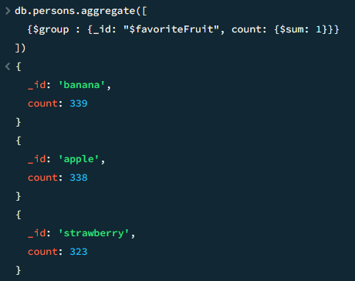
$sum with $group

Slide 10
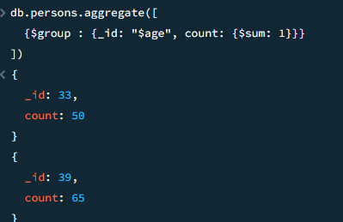
Count people of Age

Slide 11
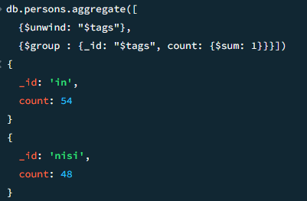
$sum

Slide 12
Question(s)

